Slide 1
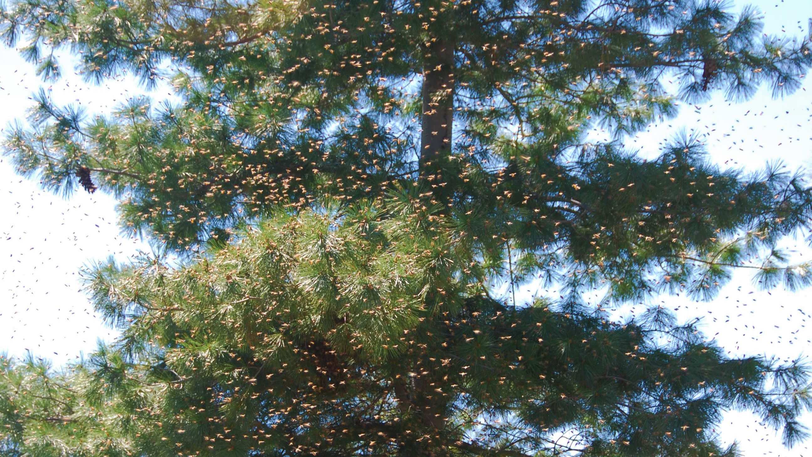
Swarm Prevention

Slide 2
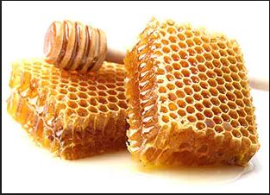
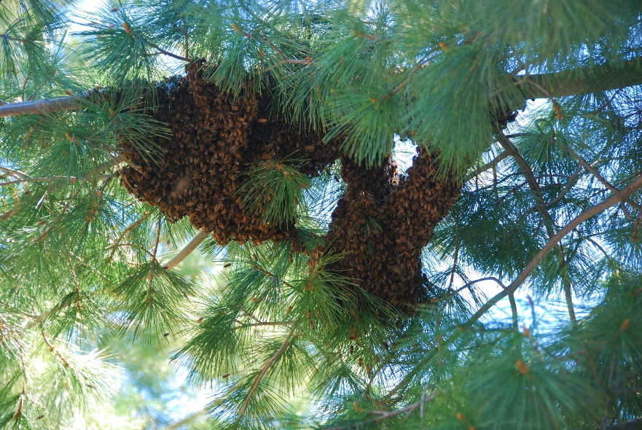
Different Goals
Main Objective of the Beekeeper?
Main Objective of the Hive?

Slide 3
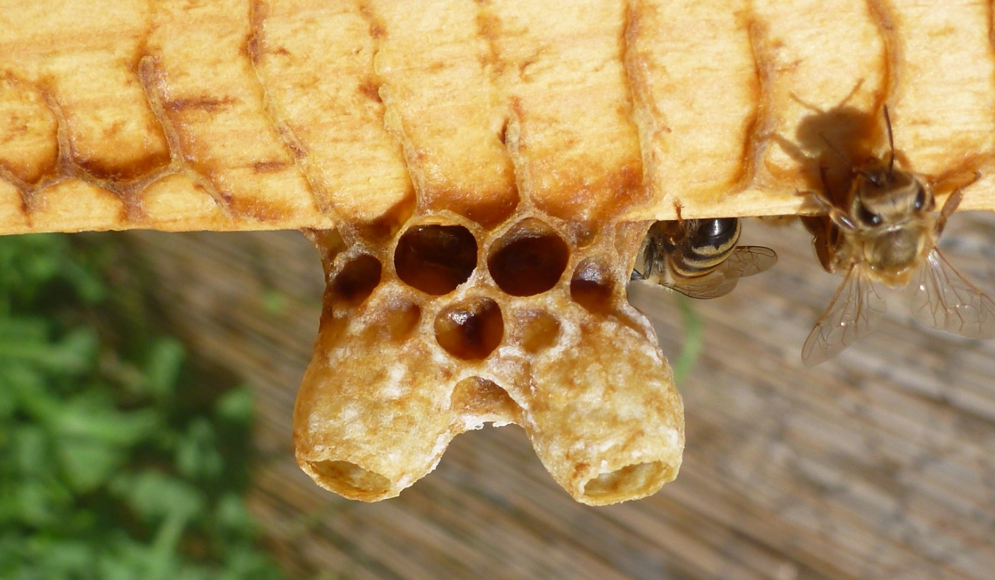
Causes of Swarming
Lack of Space
Too Much Heat
No Empty Cells
Older Queen
Instinct

Slide 4
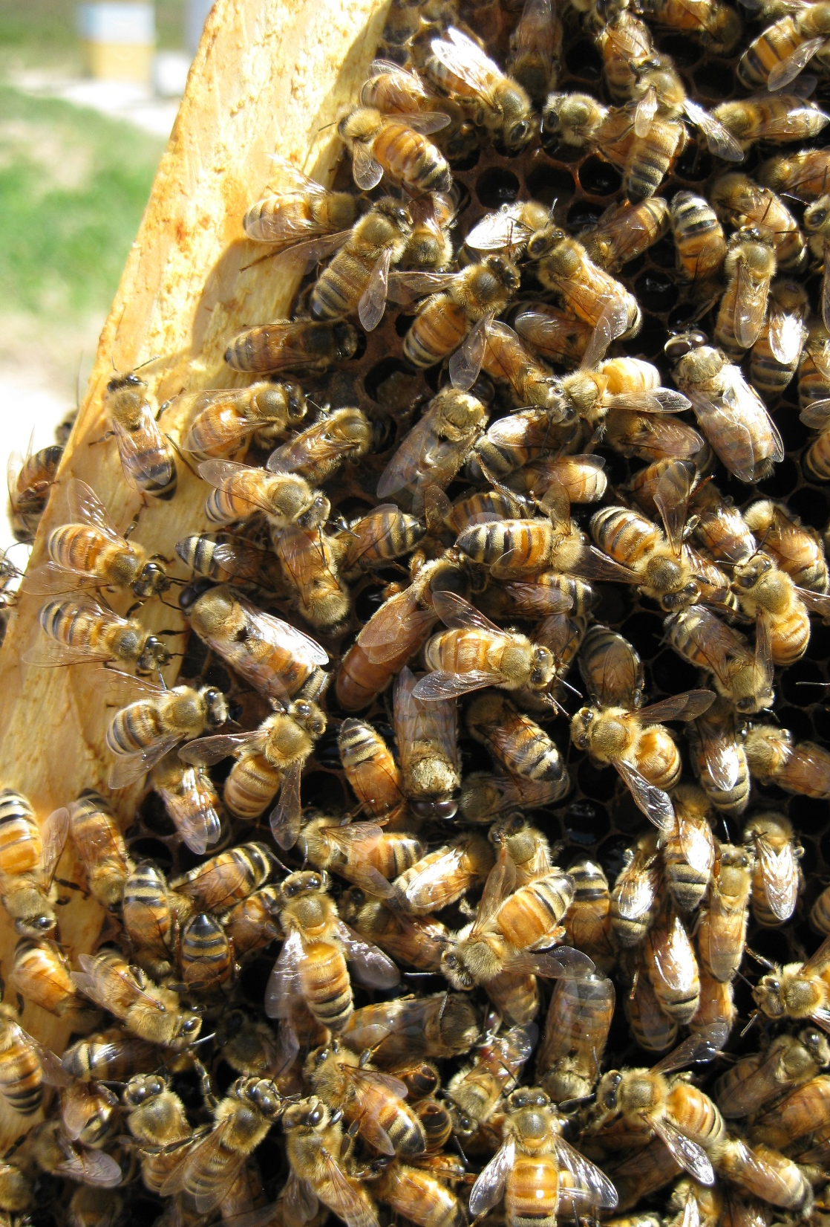
Lack of Space
Add Supers
Use Queen Excluder if Going for Honey
Switch out Frames with Empty Foundation or Drawn Comb
Checkerboarding if Multiple Boxes
Offload Full Frames to Other Hives

Slide 5
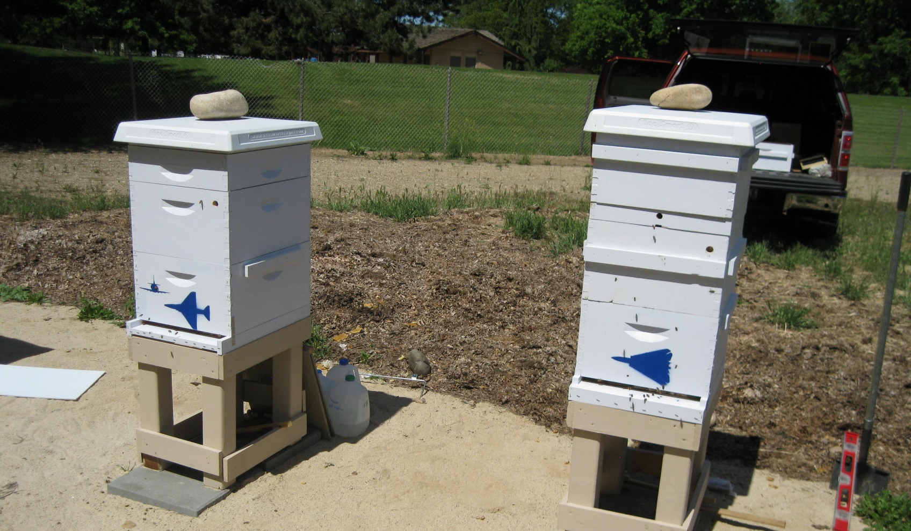
Too Much Heat
Use Vented Bottom Boards
Put Hole in Top of Brood Box
13/16^{ths} or 7/8^{ths}
Popsicle Sticks Under Telescoping Lid

Slide 6
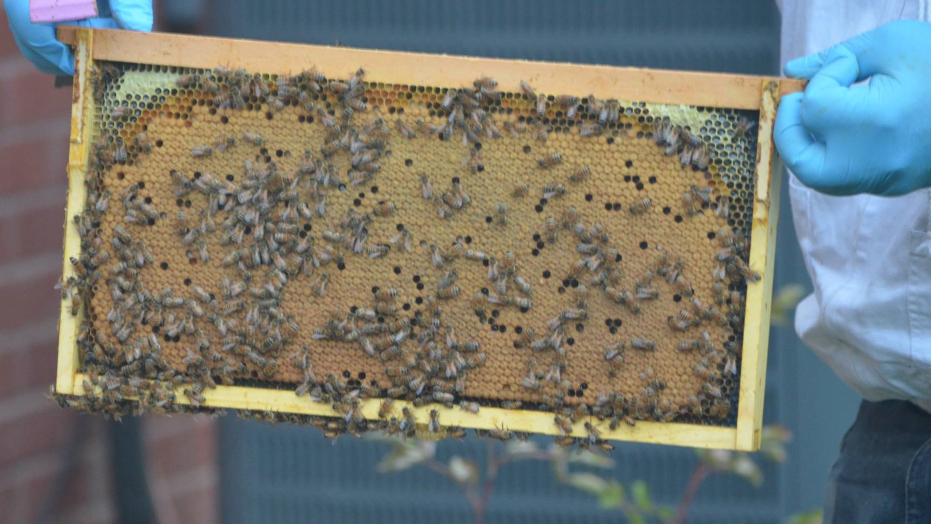
No Empty Cells
Switch out With Empty Frames
Drawn or Raw Foundation
Add Another Brood Box or Super

Slide 7
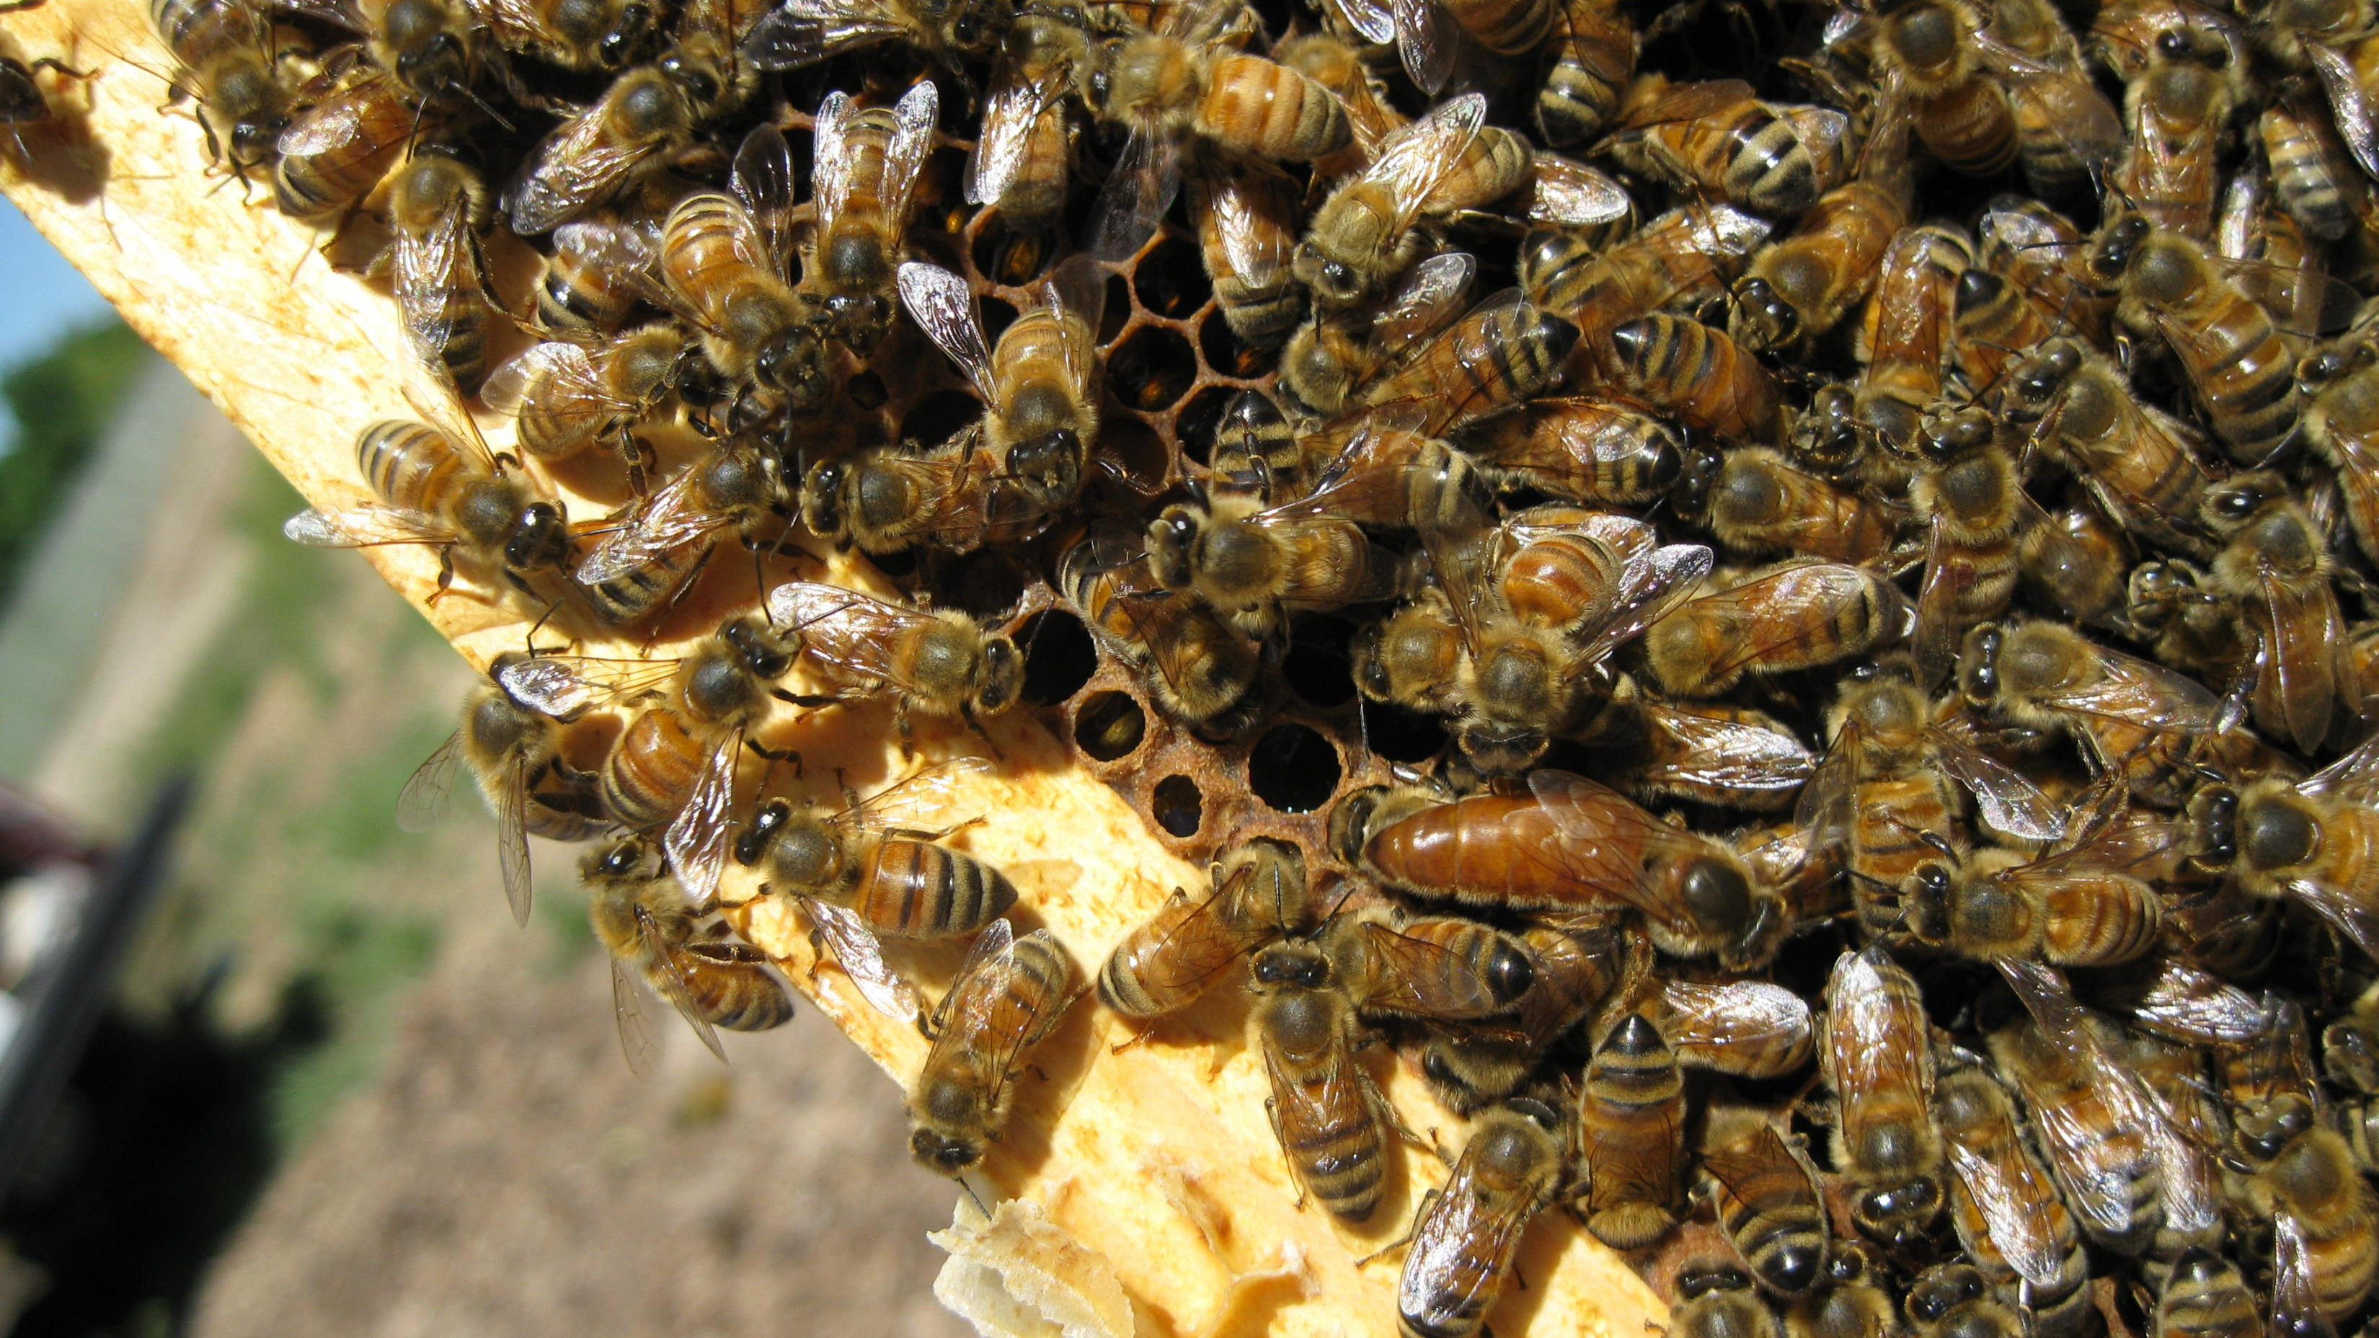
Older Queen
Max Two Years
Requeen Every Year

Slide 8
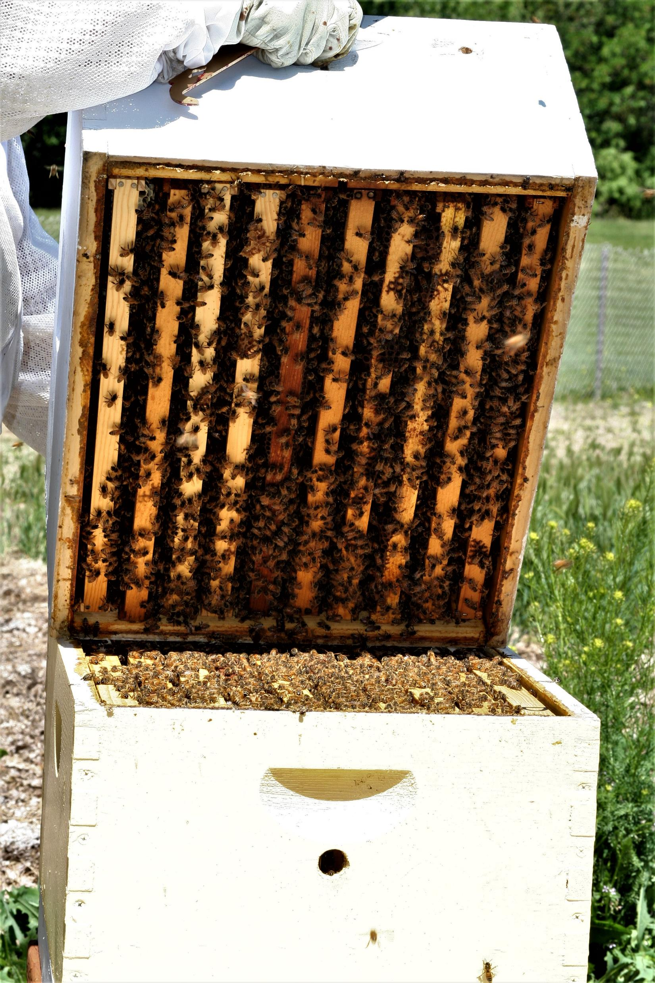
Instinct
Artificial Swarm (split)
Demaree
Walk Away
If Too Late, Only Lose ¼ of Bees

Slide 9
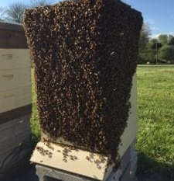
Signs of Impending Swarm
Big Population
Queen Cups
Capped or Lava
Queen Cells
Shrinking Queen
No Eggs or Young Brood
Bearding

Slide 10
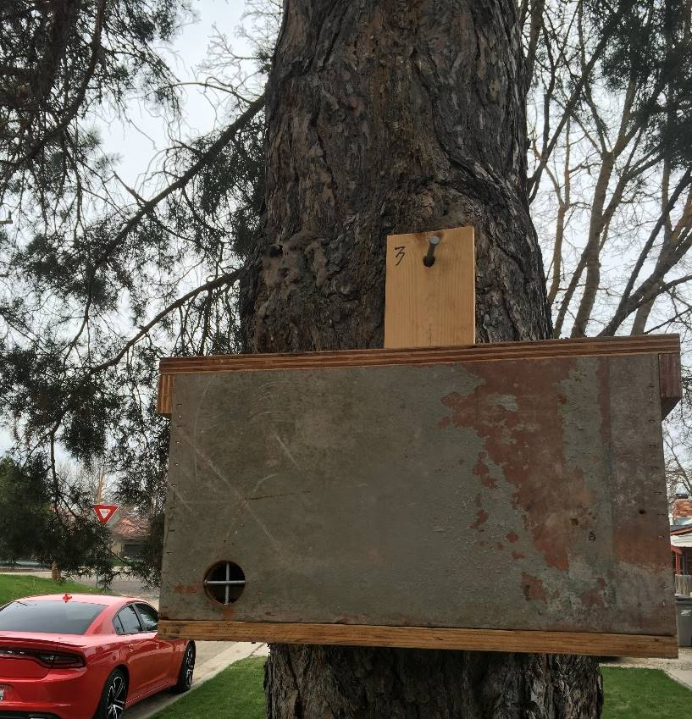
Backup Plan
Swarm Traps
Empty Hives
Equipment at the Ready

Slide 11
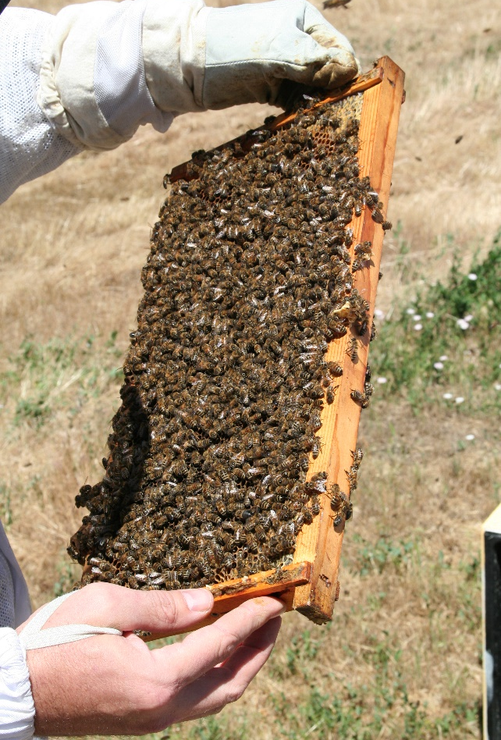
Conclusion
Inspect – You Don’t Know What You Don’t Know
Know the Signs
Get Ahead of Your Hive – Be Proactive
If None of the Above, Be Prepared

Slide 12
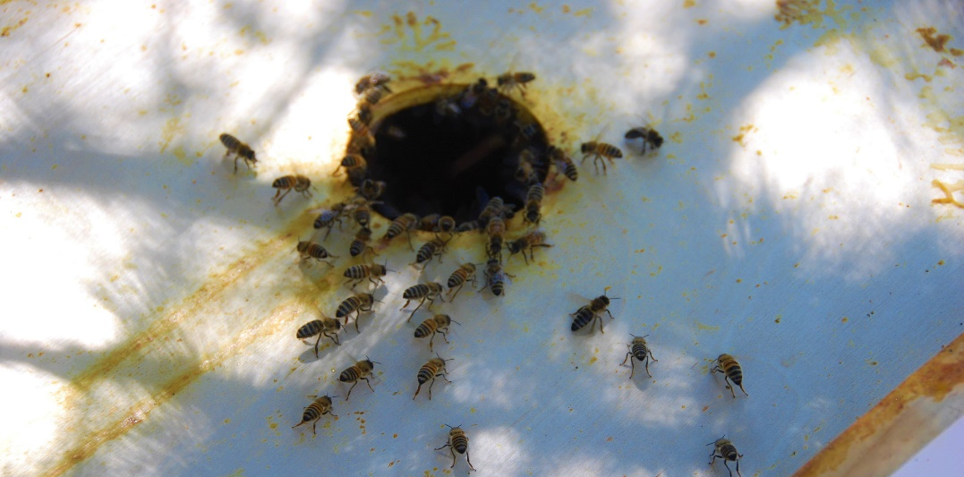
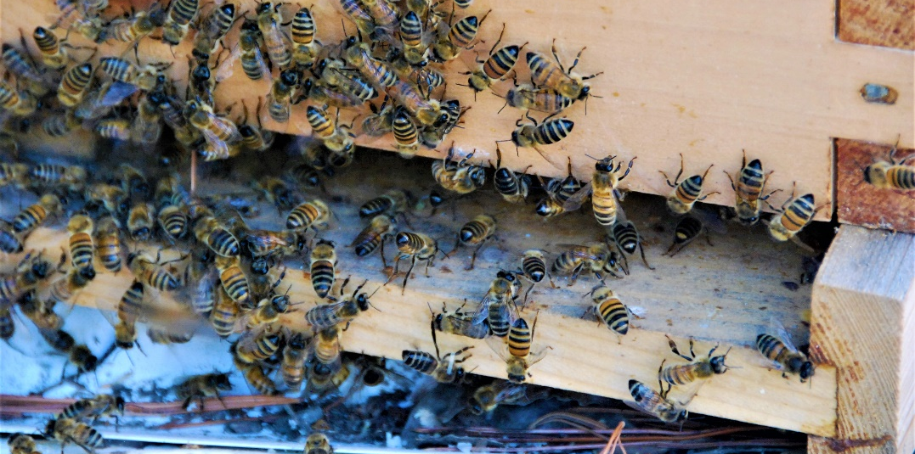
So How’d My Swarm Do?
Took Three Shakes
Used Two Deep Boxes
Still Going Strong after Three Days

